Slide 1
Towards Distributed Image Reconstruction

Slide 2
Radio Astronomy

Slide 3
SKA

Slide 4
Large Amount of Data

Slide 5
Hardware / Software

Slide 6
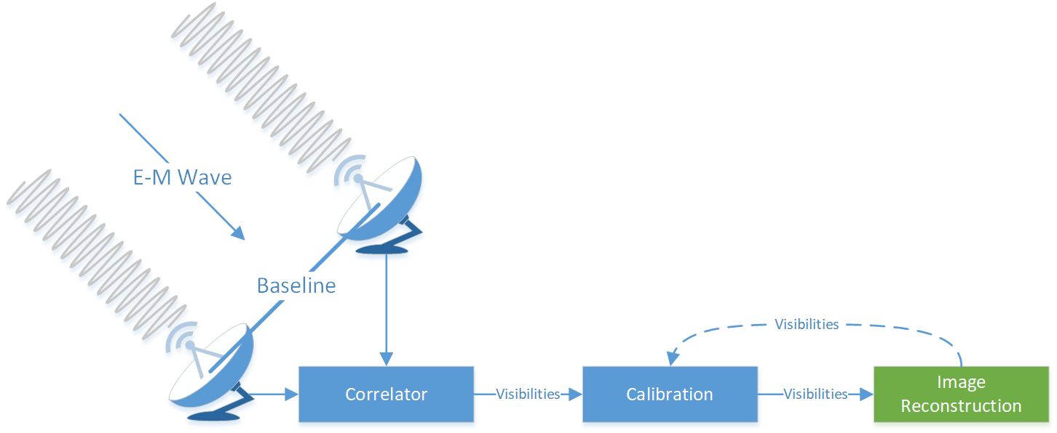
Radio Interferometry System

Slide 7
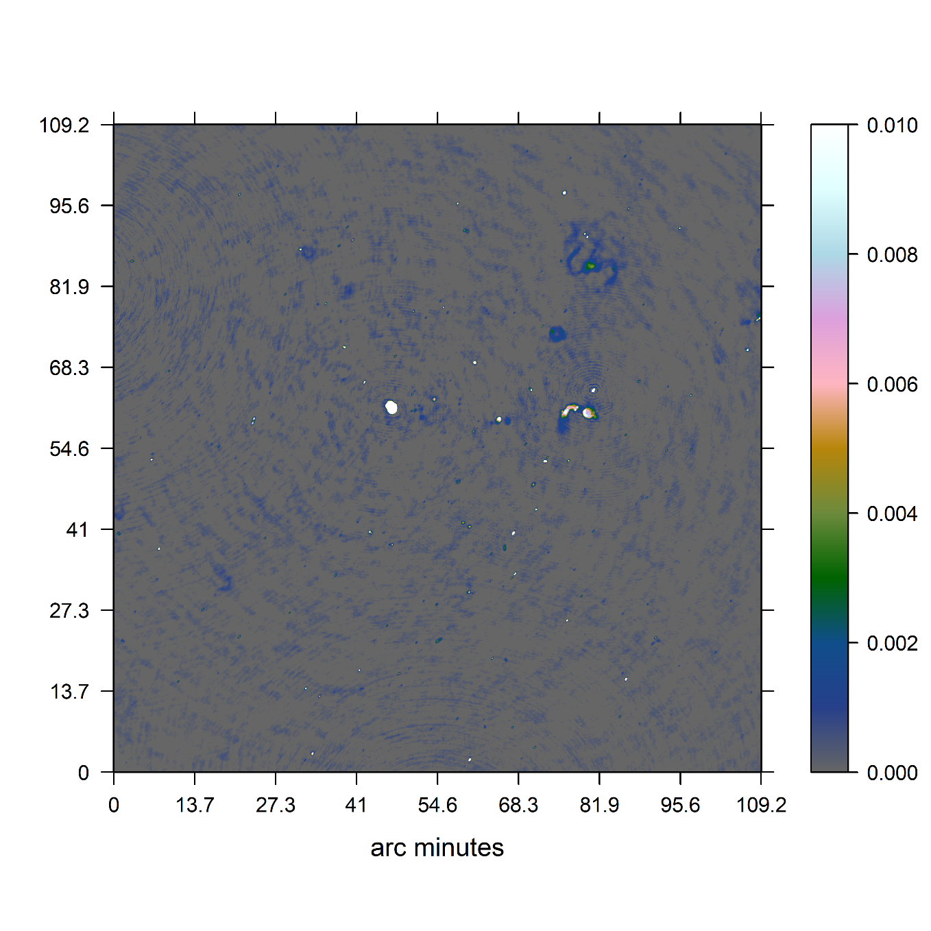
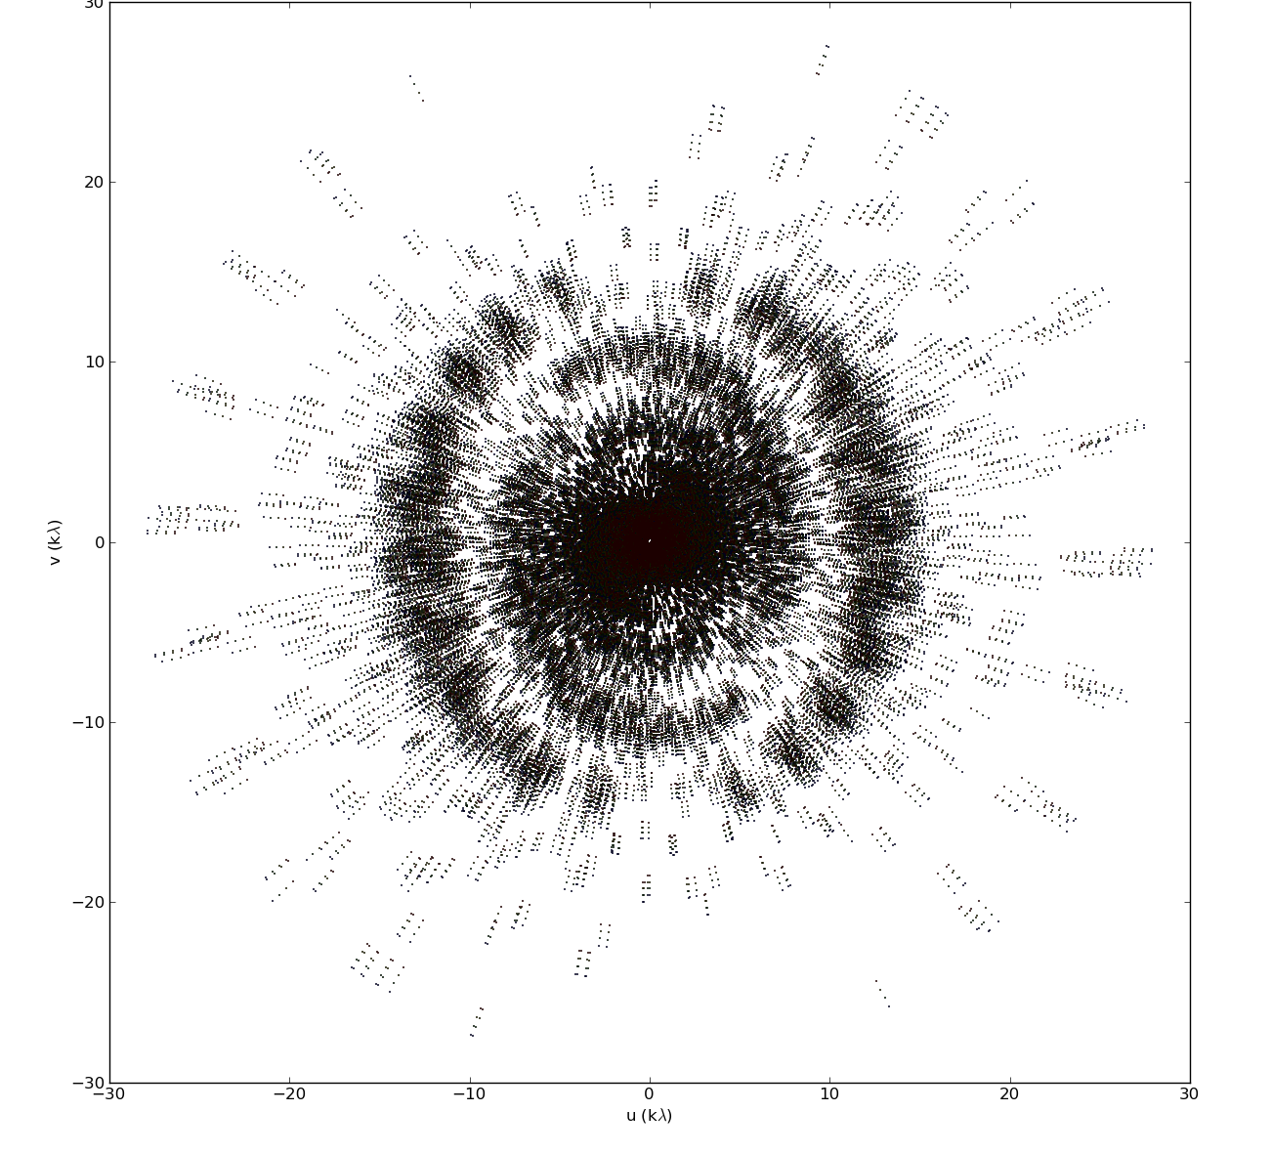
Image Reconstruction

Slide 10
Major / Minor Cycle

Slide 11
Major / Minor Cycle
~ 4 GB
32k * 32k image
< 1%
Non-Zero Pixels
Terabytes <<

Slide 12
Distribute Gridding!

Slide 13
Distribute Gridding!
May let us keep the calibrated Visibilities in-Memory
Image Domain Gridder allows us to use GPU-Acceleration
But:
All other nodes idle during Deconvolution
Deconvolution may become the most time consuming step

Slide 14
Can we use the idling nodes?

Slide 15
Can we EFFICIENTLY use the idling nodes?
Repeat as little work as possible
Communicate as little as possible
Has to be faster than single node deconvolution
Data Dependant factors

Slide 16
Data Dependant factors
How large is the grid vs. the calibrated Visibilities
How sparse is the model image
…
How large is the PSF
What is is the dynamic range of the image
Test on a real world MeerKAT observation

Slide 17
Simple Distributed Deconvolution

Slide 18
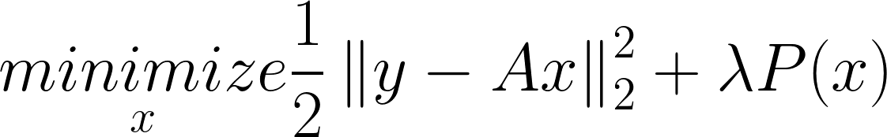
Compressed Sensing
Deconvolution == system of linear equations
Prior P() → ElasticNet
Optimization Algorithm → Coordinate Descent

Slide 19
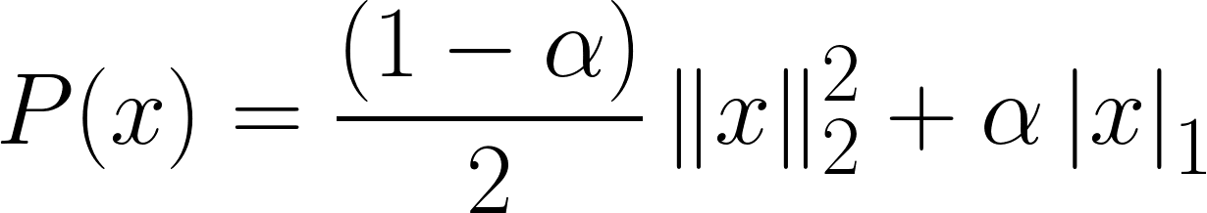
ElasticNet Prior
Mixture between L1 and L2

Slide 20
Coordinate Descent

Slide 21
Simple Distributed Coordinate Descent

Slide 22
Results
Implemented in .Net core (Platform independent)

Slide 23
Limitations
Latency Limited
Proof of concept implementation, slower than CASA tclean

Slide 24
Opportunities
Perform Coordinate Descent in parallel?
Yes, but depends on the size of the PSF
GPU Acceleration

Slide 25
Next Steps

Slide 26
GPU Baselines

